Slide 1
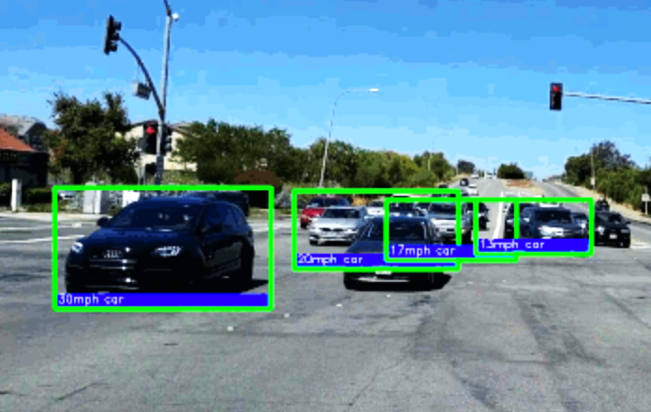
VEHICLE DETECTION AND SPEED TRACKING
UNDER THE GUIDANCE OF Dr. SASIKUMAR P
TEAM MEMBERS
M. SREE HARISH KUMAR 19W91A05C5
L V LASYA 19W91A05C1
MANNEM NIKITHA 19W91A05D4
N. SHIVA KUMAR 20W95A0516

Slide 2
ABSTRACT
There isn’t enough police force available to track the traffic and check for the speed control of vehicles.
Haar cascade is developed to detect cars on the roads, whose velocities are measured using a python script.
Easy to implement, fast to process and efficient with low cost development.
Bigger the Haar cascade, large number of vehicles can be detected.
This can be further developed to identify all kinds of vehicles plus to check anyone who breaks a traffic light.
Better search algorithms – faster search – better detection of vehicles.

Slide 3
EXISTING SYSTEM
Mobile Speed Cameras
Stop sign enforcement cameras
Fixed-speed and red light cameras
Requires more police force
Low accuracy
Radar gun is used
LIMITATIONS

Slide 4
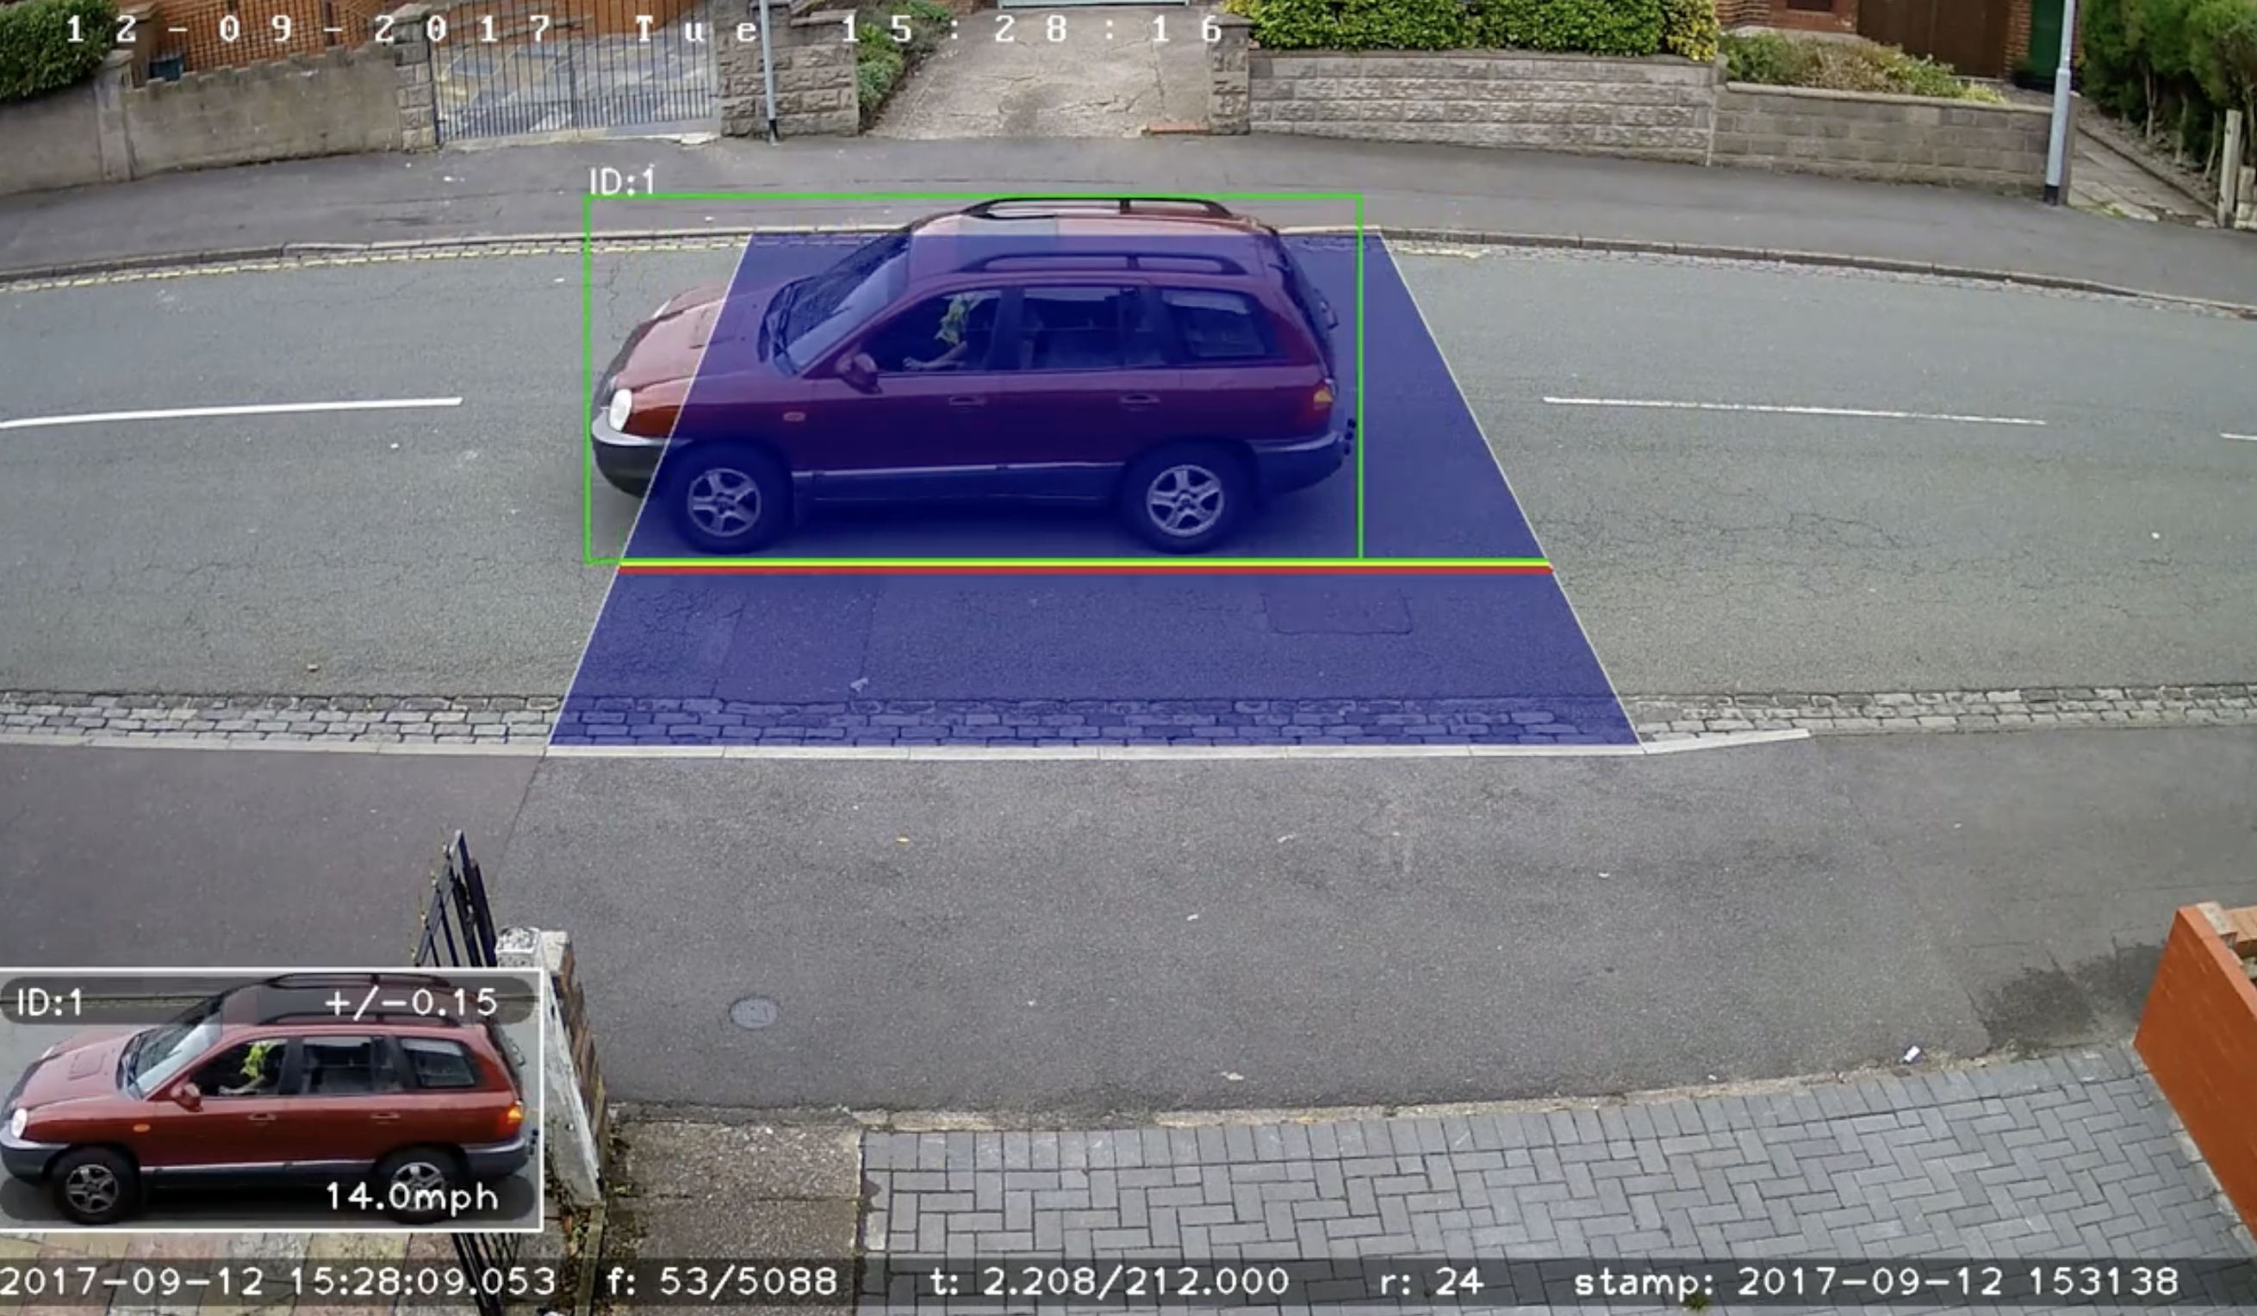
PROPOSED SYSTEM
Car detection using Haar cascades in OpenCV
Measurement of velocity of detected cars using python script
ADVANTAGES
Easy implementation, fast process, low cost development
Lower manual intervention

Slide 5
SOFTWARE AND HARDWARE REQUIREMENTS
SOFTWARE REQUIREMENTS
Operating System : Windows 10
Programming Language : Python
HARDWARE REQUIREMENTS
Processor : Intel Core i3 Processor
RAM : 4GB(minimum)
Hard disc : 500GB

Slide 6
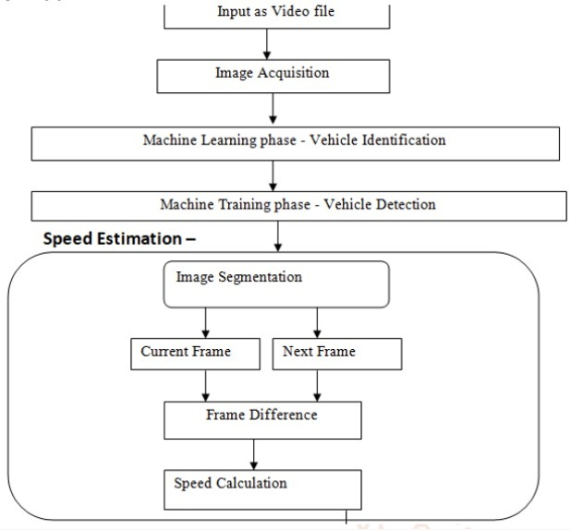
SOFTWARE ARCHITECTURE AND UML DIAGRAMS
SOFTWARE ARCHITECTURE

Slide 7
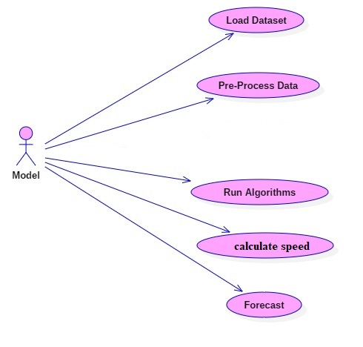
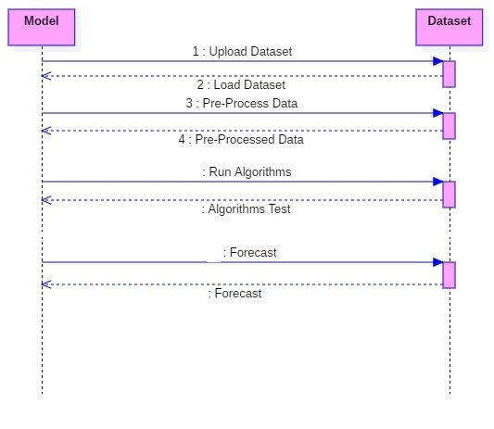
UML DIAGRAMS
USECASE DIAGRAM
SEQUENCE DIAGRAM

Slide 8
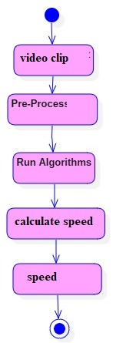
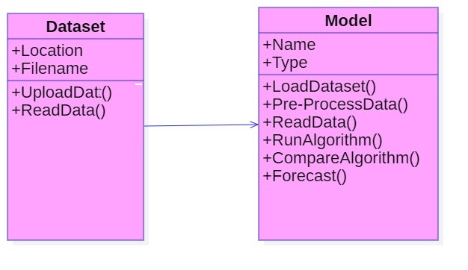
UML DIAGRAMS
CLASS DIAGRAM
ACTIVITY DIAGRAM

Slide 9
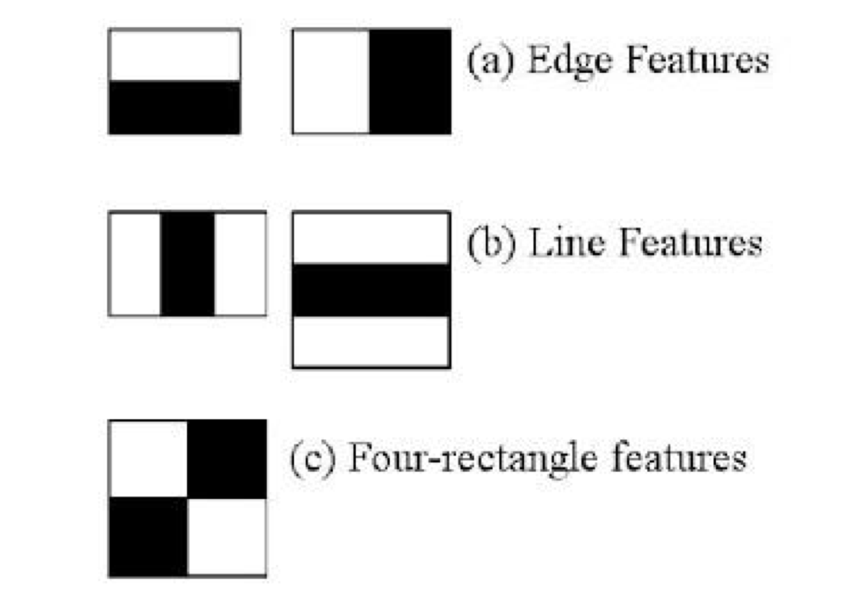
MODULES
CAR DETECTION
Haar cascade is used to detect objects in images, irrespective to their scale in image and location
Initially the calculation needs a considerable measure of positive and negative pictures without autos to prepare the classifier

Slide 10
SPEED CALCULATION
cascadeClassifier() function is used - Haar cascade is developed
Time is initialized to 0
Use the ratio in the image for each cm travelled by the detected image and real-time distance in meters, the actual distance covered by the car is calculated
As the car reaches the center of the detection window whose distance is already known to us the time is stopped
Speed is calculated
On the output screen, velocity and the camera's height above the vehicle are printed.

Slide 11
CODE EXPLANATIONS
import numpy as np
import cv2
import time
car_cascade = cv2.CascadeClassifier('hand.xml')
cap = cv2.VideoCapture('car.mp4')
wide=0.1 #depends upon size of car(~2.5)
flag=True
start=end=0
time_diff=0
while(cap.isOpened()):
ret, img = cap.read()
height,width,chan=img.shape
#print(height,width,chan)
cars = car_cascade.detectMultiScale(gray, 1.3, 5)

Slide 12
#crp=gray[0:480,0:int(width/2)+10]
for(x,y,w,h) in cars:
cv2.rectangle(img, (x,y), (x+w,y+h), (0,255,0),2)
#print(center_x,center_y)
dist1=((wide*668.748634441)/w)
#print("Distance from car:",round(dist1,2),"m")
roi_gray = gray[y:y+h,x:x+w]
roi_color = img[y:y+h,x:x+w]
dist0=((wide*668.748634441)/w)
actual_dist=dist0*(width/2)/668.748634441
#print("Actual Distance:",actual_dist)
if flag is True and int(round(center_x)) in (range(0,80) or range(400,480)):
start=time.time()
flag=False
#print("Start:",start)
if flag is False and int(round(center_x)) in range(int(round(width/2))-10,int(round(width/2))+10):

Slide 13
end=time.time()
time_diff=end-start
#print("End:",end)
flag=True
s_flag=True
#print("Time Difference:",time_diff)
if time_diff>0 and s_flag==True:
velocity=actual_dist/time_diff
#print(round(start),round(end))
vel_kmph=round(velocity*3.6,2)
print("Speed:",vel_kmph,"kmph")
print("Distance from car:",round(dist1,2),"m")
s_flag=False

Slide 14
cv2.line(img,(int(width/2),0),(int(width/2),height),(255,0,0),2)
cv2.imshow('frame',img)
if cv2.waitKey(1) & 0xFF == ord('q'):
break
cap.release()
cv2.destroyAllWindows()

Slide 15
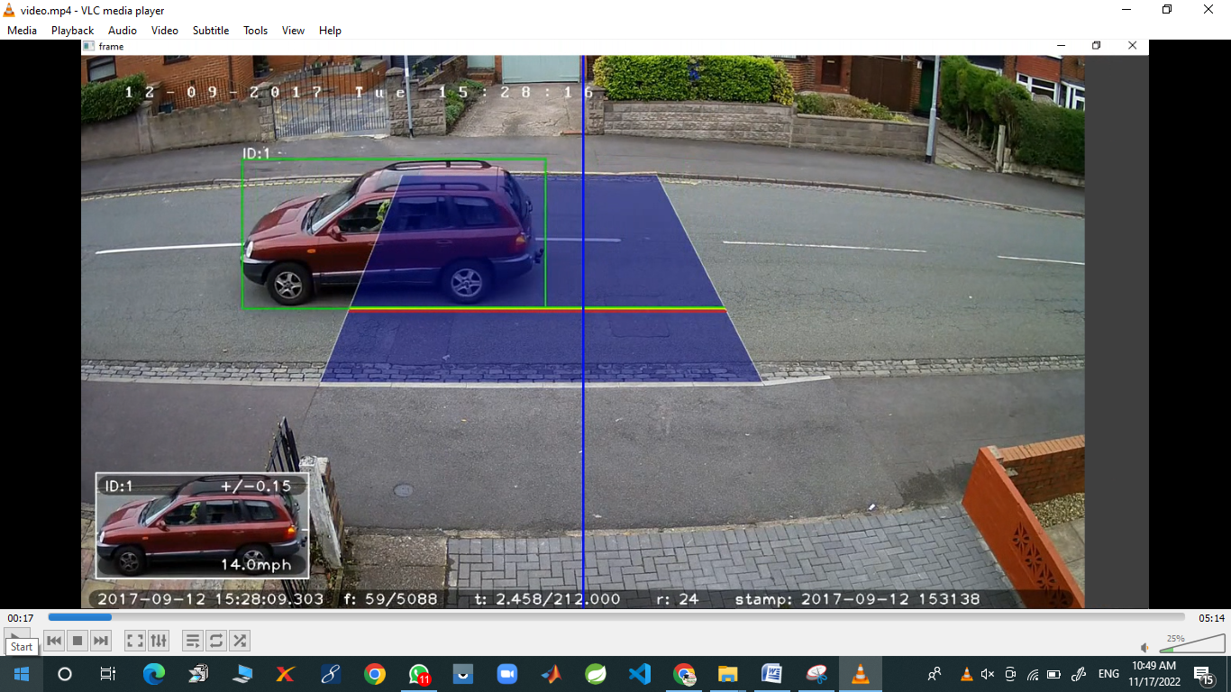
OUTPUT SCREENS

Slide 16
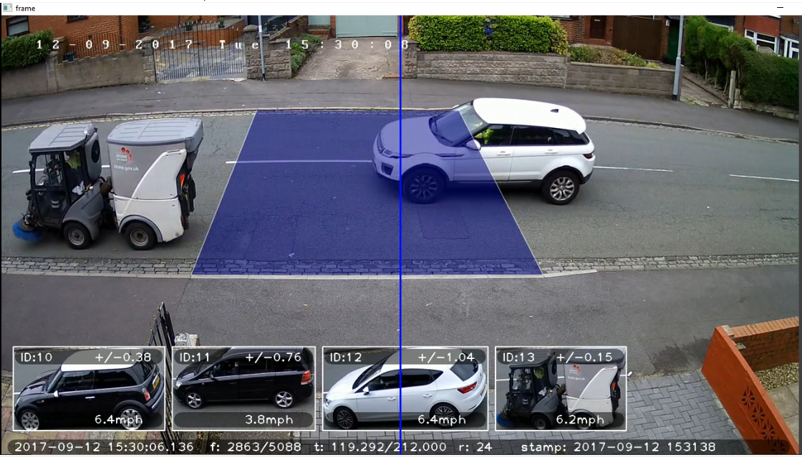

Slide 17
CONCLUSION
The real-time application of this project proves to be much useful as it is easy to implement, fast to process and efficient with low cost development.
Also, the tool might be useful to apply in simulation tools to measure velocities of cars.
This can be further developed to identify all kinds of vehicles as well as to check anyone who breaks a traffic light.

Slide 18
REFERENCES
Zusheng Zhang, Tiezhu Zhao, Xin Ao, and Huaqiang Yuan A Vehicle Speed Estimation Algorithm Based on Dynamic Time Warping Approach IEEE SENSORS JOURNAL, VOL. 17, NO. 8, APRIL 15, 2017
Mahmoud Famouri, Zohreh Azimifar, Member, IEEE, and Alexander Wong , Senior Member, IEEE A Novel Motion Plane-Based Approach to Vehicle Speed Estimation IEEE TRANSACTIONS ON INTELLIGENT TRANSPORTATION SYSTEMS
W. Czajewski and M. Iwanowski, “Vision-based vehicle speed measurement method,” in Computer Vision and Graphics. ICCVG (Lecture Notes in Computer Science), vol. 6374, L. Bolc, R. Tadeusiewicz, L. J. Chmielewski, and K. Wojciechowski, Eds. Berlin, Germany: Springer, 2010, pp. 308–315.
Lan, J. Li, G. Hu, B. Ran, and L. Wang, “Vehicle speed measurement based on gray constraint optical flow algorithm,” Optik-International Journal for Light and Electron Optics, vol. 125, no. 1, pp. 289–295, 2014.
H. Sundoro and A. Harjoko, “Vehicle counting and vehicle speed measurement based on video processing,” Journal of Theoretical and Applied Information Technology, vol. 84, no. 2, pp. 233–241, 2016.
A. G. Rad, A. Dehghani, and M. R. Karim, “Vehicle speed detection in video image sequences using cvs method,” International Journal of Physical Sciences, vol. 5, no. 17, pp. 2555–2563, 2010

Slide 19
THANK YOU

